Slide 2
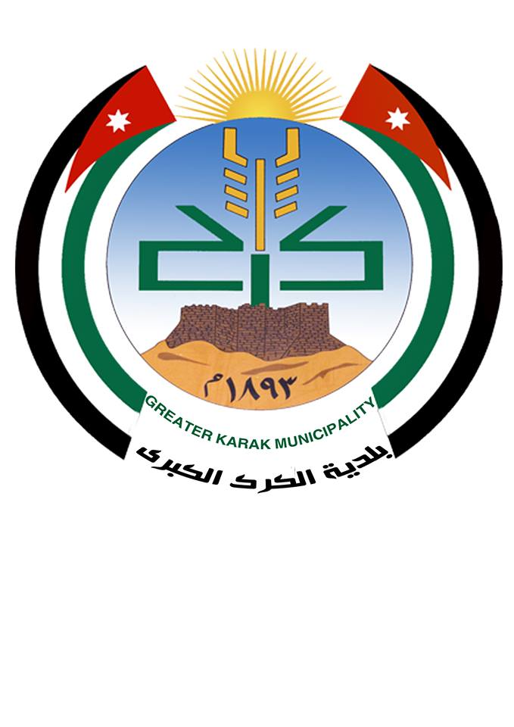
Logo of Karak Manuiciplity

Slide 3
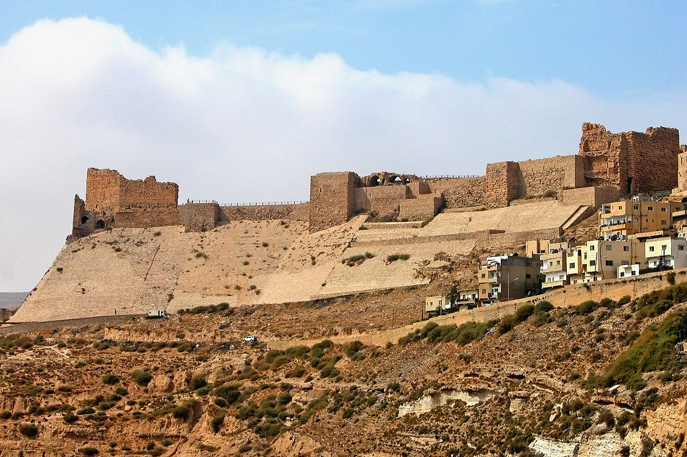
Castle of al karak

Slide 4

The history of this city date back to iron age and was ruled by the Moabites ,Assyrians, Nabateans, Greeks, Romans and Byzantines.

Slide 5
Area of the city = 34947 km² population = 316629
The most important tourist features:
1- Castle al karak.
2- Dead sea.
3-Wadi Bin Hammad.
4-Many archaeological and tourist sites of all kinds.

Slide 6
Introduction:
The greater al karak municipilaty was established in 1893.
The first mayor of al karak al sheikh daleywan al majale.
Now the mayor of al karak mr. ibrahim al karacy.

Slide 7
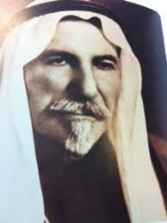
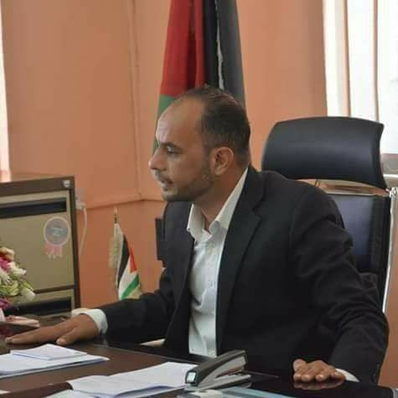
Al sheikh daleywan Majal Mr. ibrahim Al Karacy

Slide 8
The mayor and the members of the council shall be elected.
The municipality has 14 areas.
Services are provided such as (electricity, cleaning, water, sewerage system, and others)
The municipality has 800 employees.

Slide 9
In last years ,it has evolved remarkably through by structure and development projects. Which employ a number of unemployed .

Slide 10
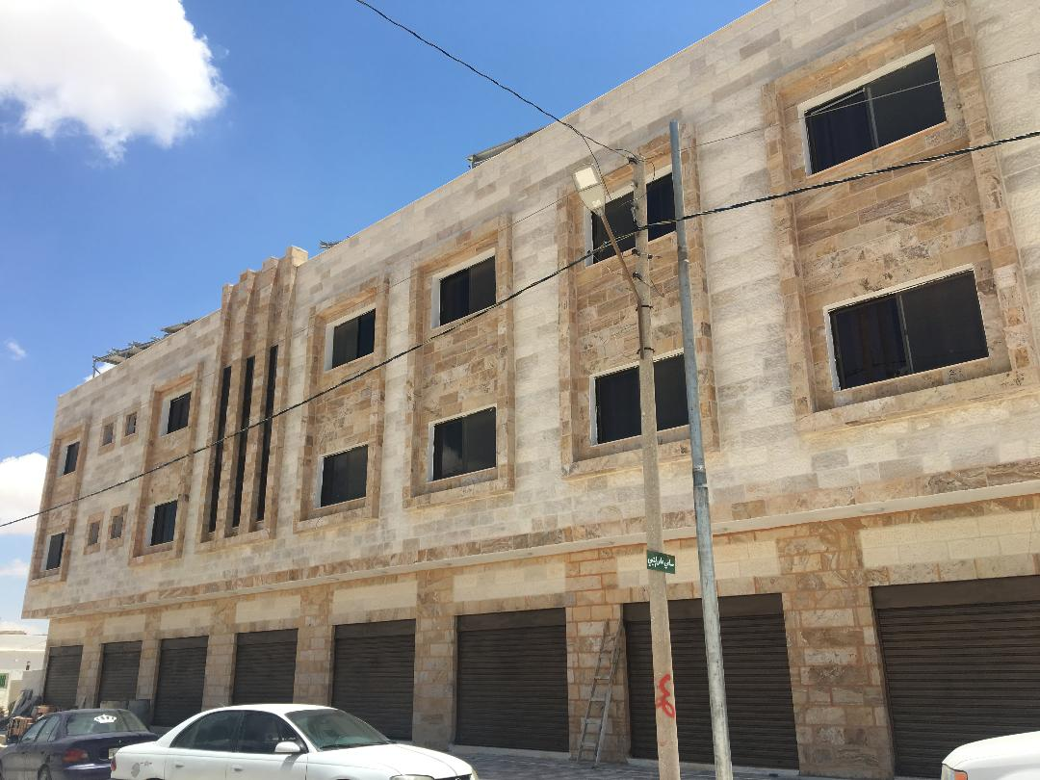
Some of major projects
1-student accommodation

Slide 11
Consists of 35 rooms and works on solar energy.

Slide 12
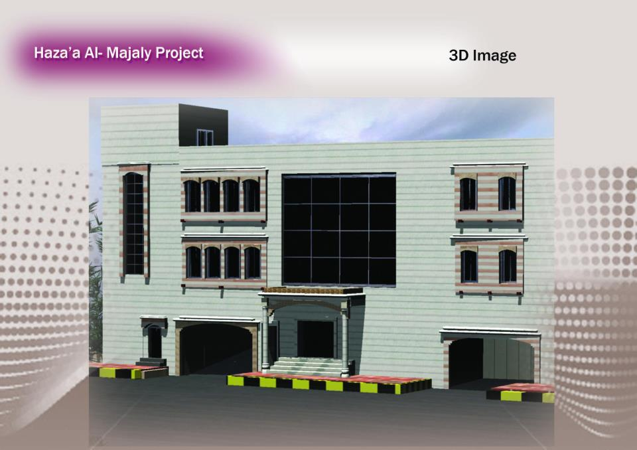
2- hazaa al majali complex:

Slide 13
Consists of parking for car and halls for meetings and any events.

Slide 14
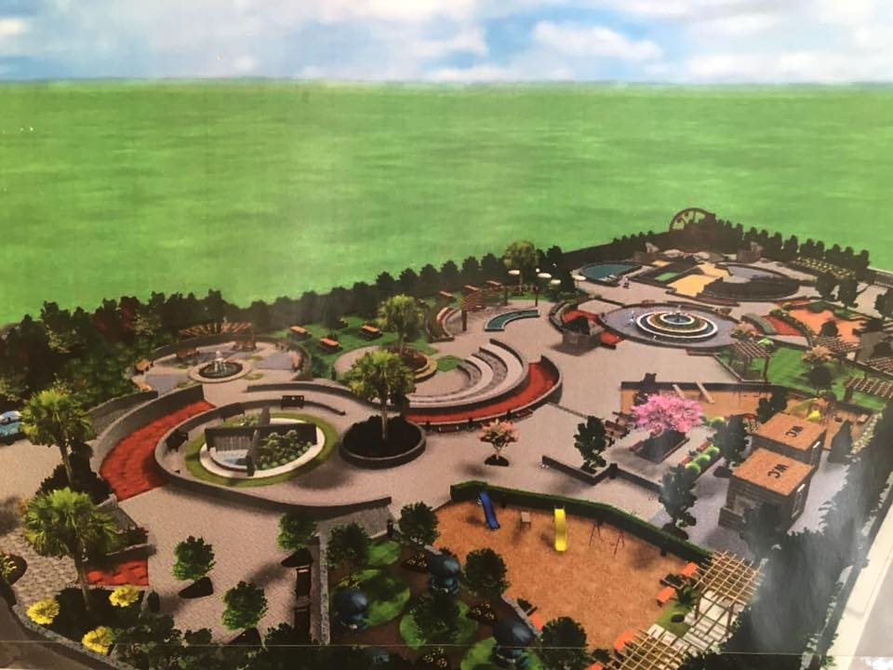
3- Al karak park

Slide 15
4- solar cell farms to produce 3 m.
5- factory to produce waste containers.
6- factory to produce organic fertilizer.
And many projects which are running the unemployed .

Slide 16



